Slide 1
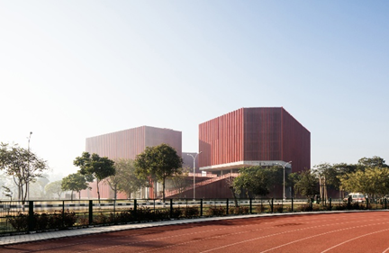

AI-Driven Modelling and Optimization of Breast Cancer Detection and Treatment through Magnetically Induced Hyperthermia Therapy
Presentation on
TIET-UQ Centre of Excellence in Data Science and AI (DSAI)
Team:
Dr. Neeraj Kumar (PI), Dr. Jainy Sachdewa (Co-PI)
Sandeep nain (RA) & Interns @ Ganeev, Keshav and Armaan Mittal
Assessment Committee
CoE-DSAI UQ-TIET,
TIET, Patiala, Punajb, India

Slide 2
Contents
Problem Statement
Related literature review
Gap and objective
Data components, and Model Architecture
Novality
Results and metrices
Progress so far
Future direction
References

Slide 3
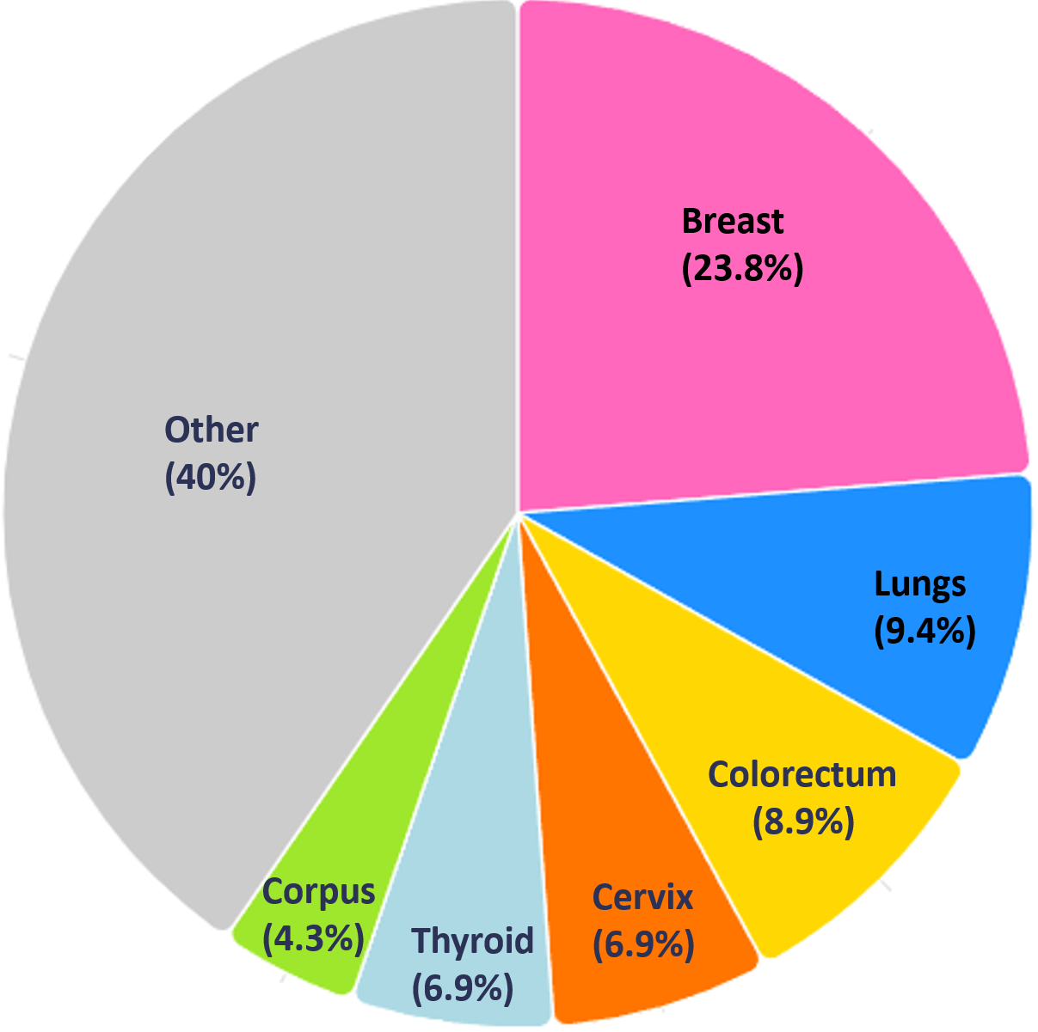
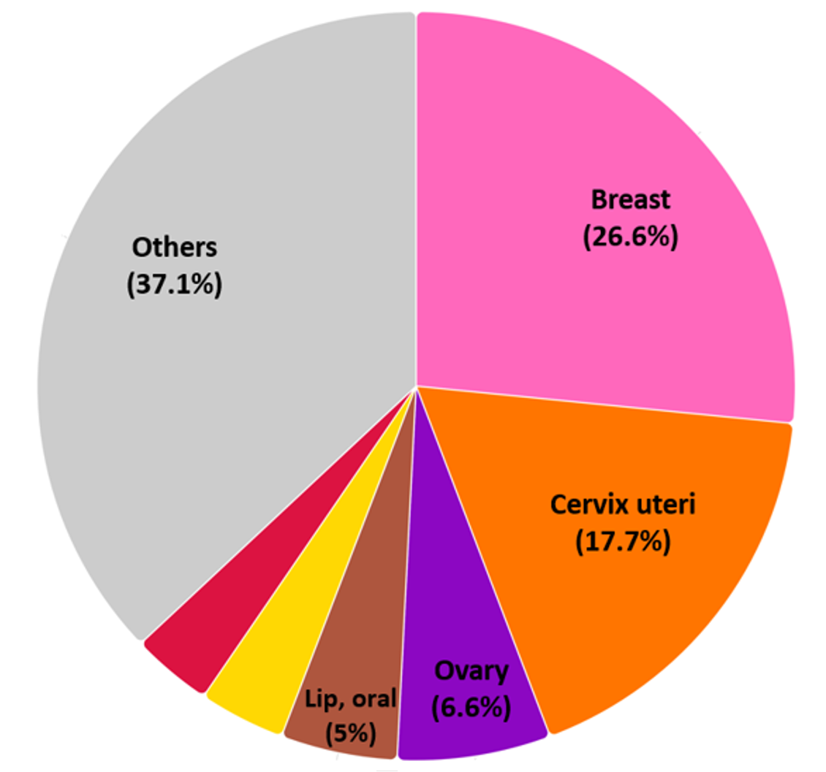
Problem Statement
Breast Cancer - Major Concern
WHO, Absolute numbers, Incidence, Females, in 2022
World
India
Mortalities
15.4%
22%

Slide 4
Motivation for Patient Specific Breast Tumor Segmentation
The globally high incidence but also substantial mortality is due to the delayed diagnosis and limited access to expert radiological assessment.
Individual patient have a specific unique anatomical structure, tumor morphology, tissue density etc. These factors directly influence diagnosis, treatment planning, and outcome prediction.
Accurate patient-specific tumor segmentation from breast MRI is therefore a critical enabling step for • Early and reliable detection with clear boundary delineation • Reduction of inter-observer variability, and Support for radiologists under increasing workload.
The execution is based patient-specific physical model that integrates real-time data, AI, and simulations to optimize hyperthermia-based breast cancer treatment as a digital twin.
So, the development of automated and learning based approaches that can generalise across scanners, institutions, and patient populations is our target.

Slide 5
Literature
S.NO | Author(s), Year | Dataset / Materials | Methods / Model Used | Key Findings | Result
1. | Lukas Hirsch et al. [1] | Very large MRI dataset: 64,063 scans from 14,475 patients (2,555 cancers + 60,108 benign) | 3D U-Net with intensity normalization & harmonization | segmented breast cancers with performance comparable to radiologists, and reduces human workload | On test set, median Dice = 0.77 (IQR 0.26)
2. | Haoxuan Li et al. [2] | Yunnan hospital, and MAMA MIA: 100, and 1506 patients | Hybrid CNN-Mamba Attention (HCMA) | Resonable generalisation over three data set | Dice over Yunnan= 78%, And over MAMA Mia=76.1
3. | Lidia Garrucho et al. [3] | Created data set with 16 BC experts@ MAMA MIA | nnU-Net model | Quality data set generation | 5 fold cross validation Dice=76.20
4. | C. Sahaya Pushpa Sarmila Star et al. [4] | QIN Breast DCE-MRI dataset : 233 | DeepLabV3+ with PLA-RN50 @2D model | provide greater accuracy and better generalization capabilities, traditional segmentation techniques | Dice: 92%, Acc:99.94, Precisio:95.56
Gap
Existing approaches demonstrate strong segmentation performance, but lack robust cross-data-set generalisation, and targeted tumor-focused attention within a flexible 3D architecture.

Slide 6
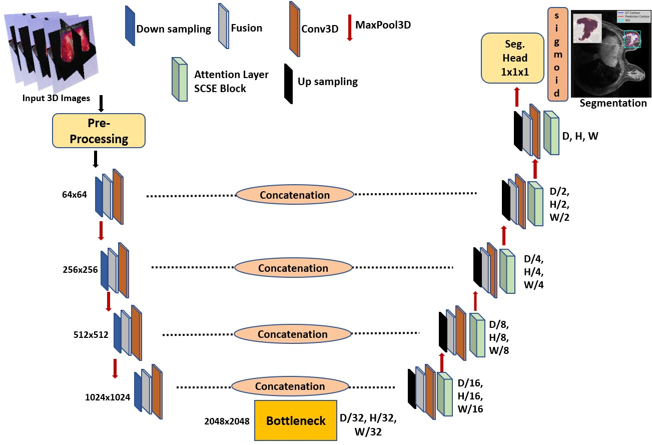
Model Architecture
Objective: Breast Cancer Segmentation and Prediction
Data Components
Yunnan Cancer Hospital (100 Patients)
MAMA-MIA dataset (1506 Patients)
DCE-MRI volumes of breast tissue.
Multi-phase contrast images for tumor dynamics
Voxel-wise ground truth annotations for tumors
Deep learning frameworks (PyTorch, MONAI).
3D Flexible U-Net
Backbone: 3D ResNet-50 encoder.
Decoder: UNet-style with transposed convolutions.
Skip connections between encoder and decoder.
Custom scSE attention applied to decoder outputs for focus on tumor regions.
Hybrid flexible custom SSCE Attention model

Slide 7
Training Setup
Loss Function: DiceCE and Focal Tversky
Data & Pre-processing
Multi modality medical images.
Spatial standardization, and normalization : resampled to isotropic 1 mm resolution and reoriented including random flips, rotations, affine transformations, noise injection, smoothing, and contrast variation.
Patch based sampling: Balanced positive and negative patches are randomly sampled around labeled regions.
Data augmentation Robust spatial and intensity augmentations are applied, including random flips, rotations, affine transformations, noise injection, smoothing, and contrast variation.
Hybrid optimization objective A composite loss combining Dice Cross Entropy loss and Focal Tversky loss is used to balance region overlap accuracy and voxel level classification in a weighted configuration.
Dice Cross Entropy component Encourages stable convergence by jointly optimizing volumetric overlap which is effective for medical segmentation.
Focal Tversky component it addresses class imbalance by penalizing false negatives more than false positives, while the focal term emphasizes harder to segment regions.
Optimizer: AdamW (lr=1e-4, wd=1e-5).
Batch Size: 2–4 (fits 70GB GPU).
Epochs: 500.

Slide 8
Novelty of the framework
Light weight
Deployable
Attention head is modular, compatible to other frameworks
Piplines are simple and logical.
Generalisability.
Modular pre-processing pipeline

Slide 9
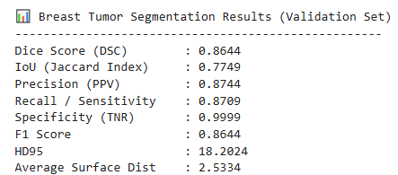
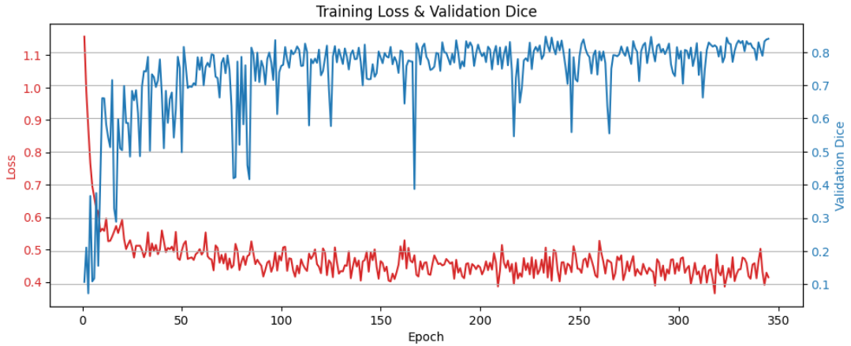
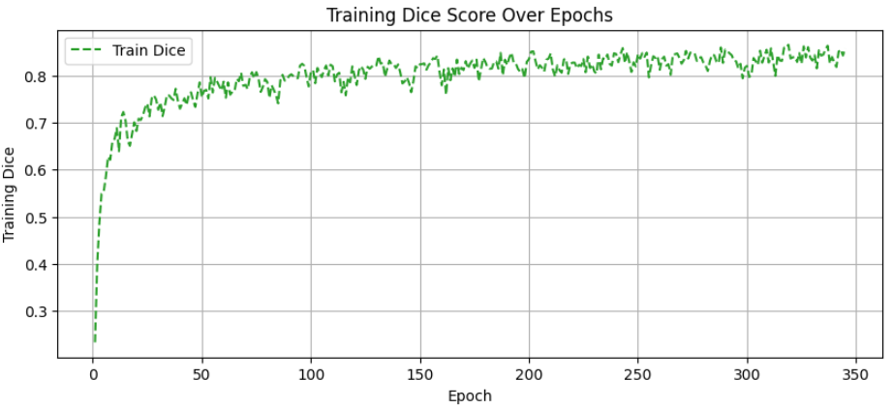
Results & Metrics
Yunnan Hospital Data set (Public)
Validation Mean Dice: 86.44
Training loss: smooth convergence.
Best model saved at epoch with max Dice.
Goal: push Dice > 0.85 on generalization.
Fig. Training loss (red) and validation Dice Score over epochs

Slide 10
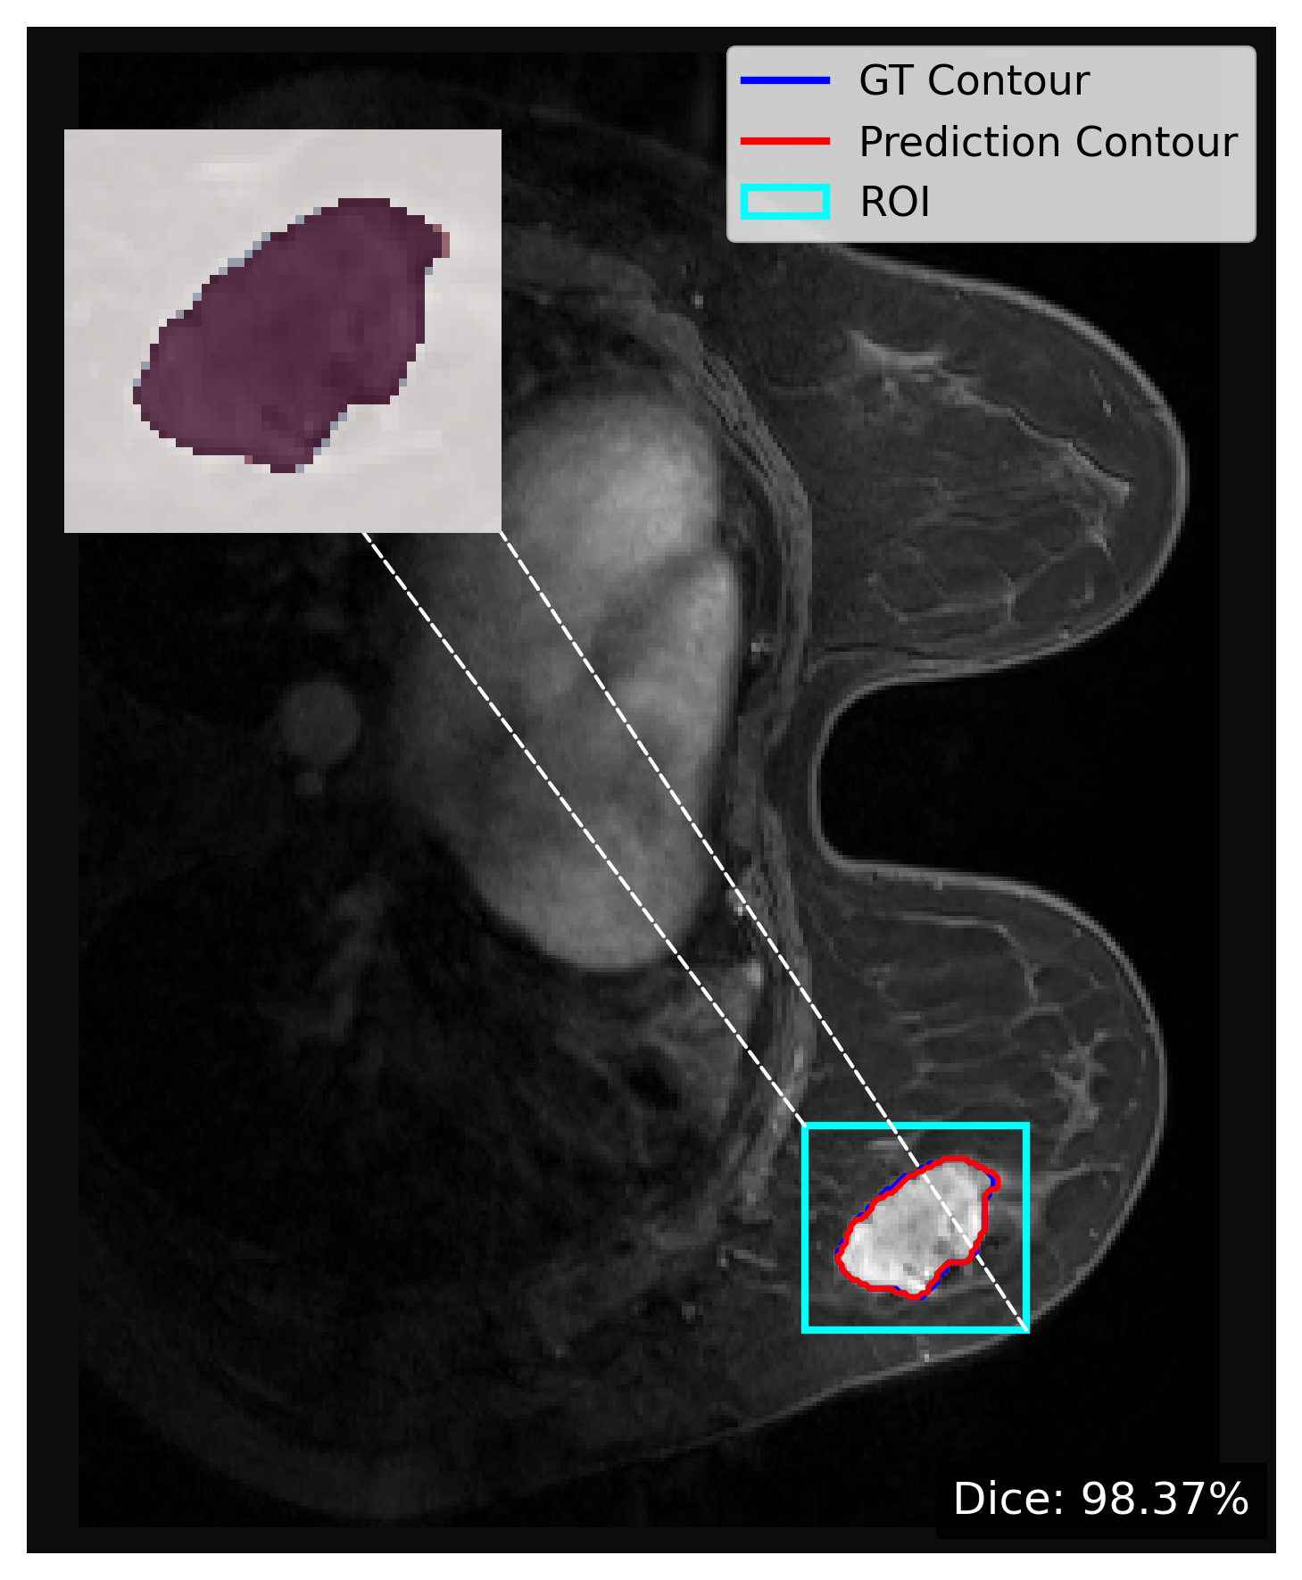
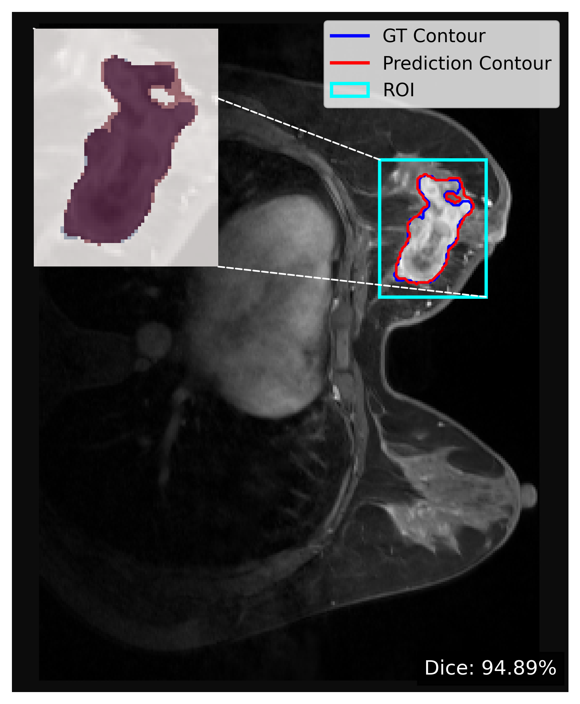
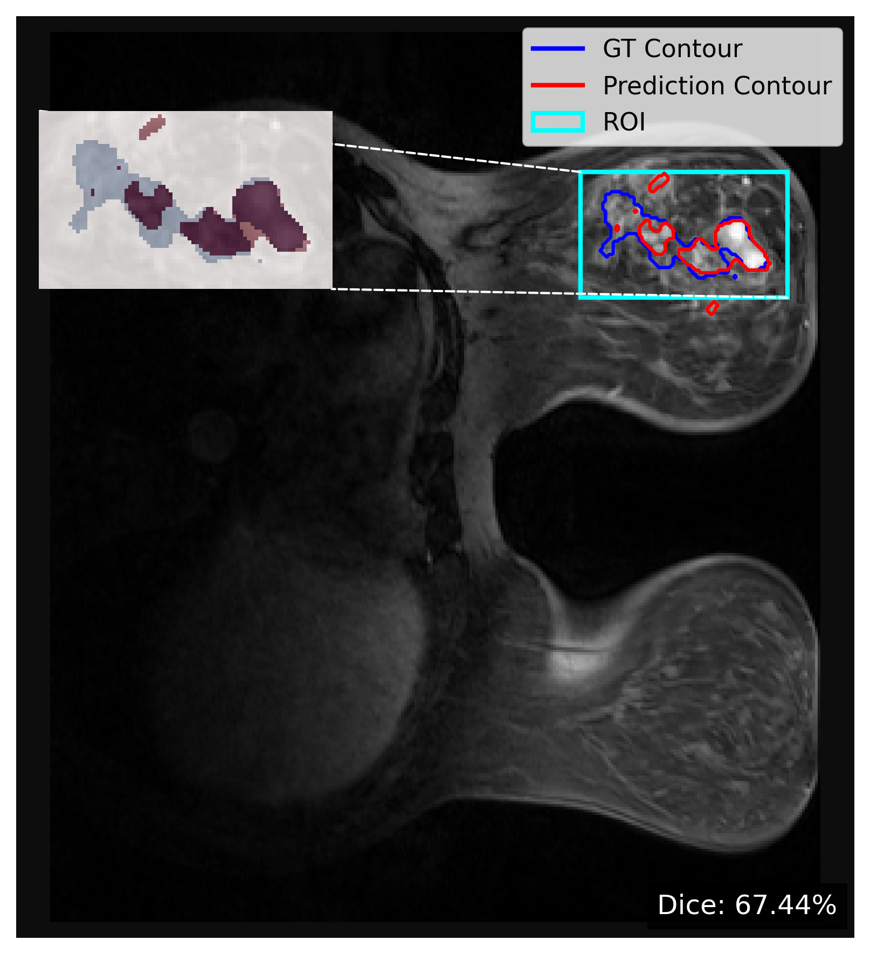
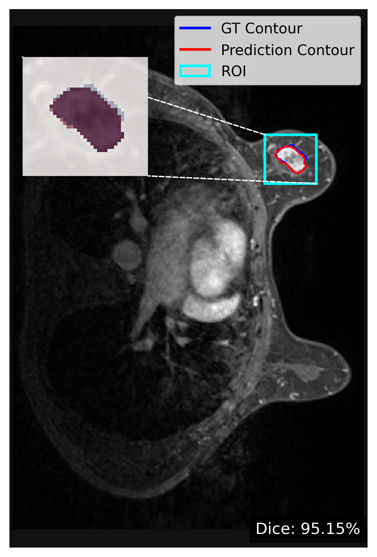
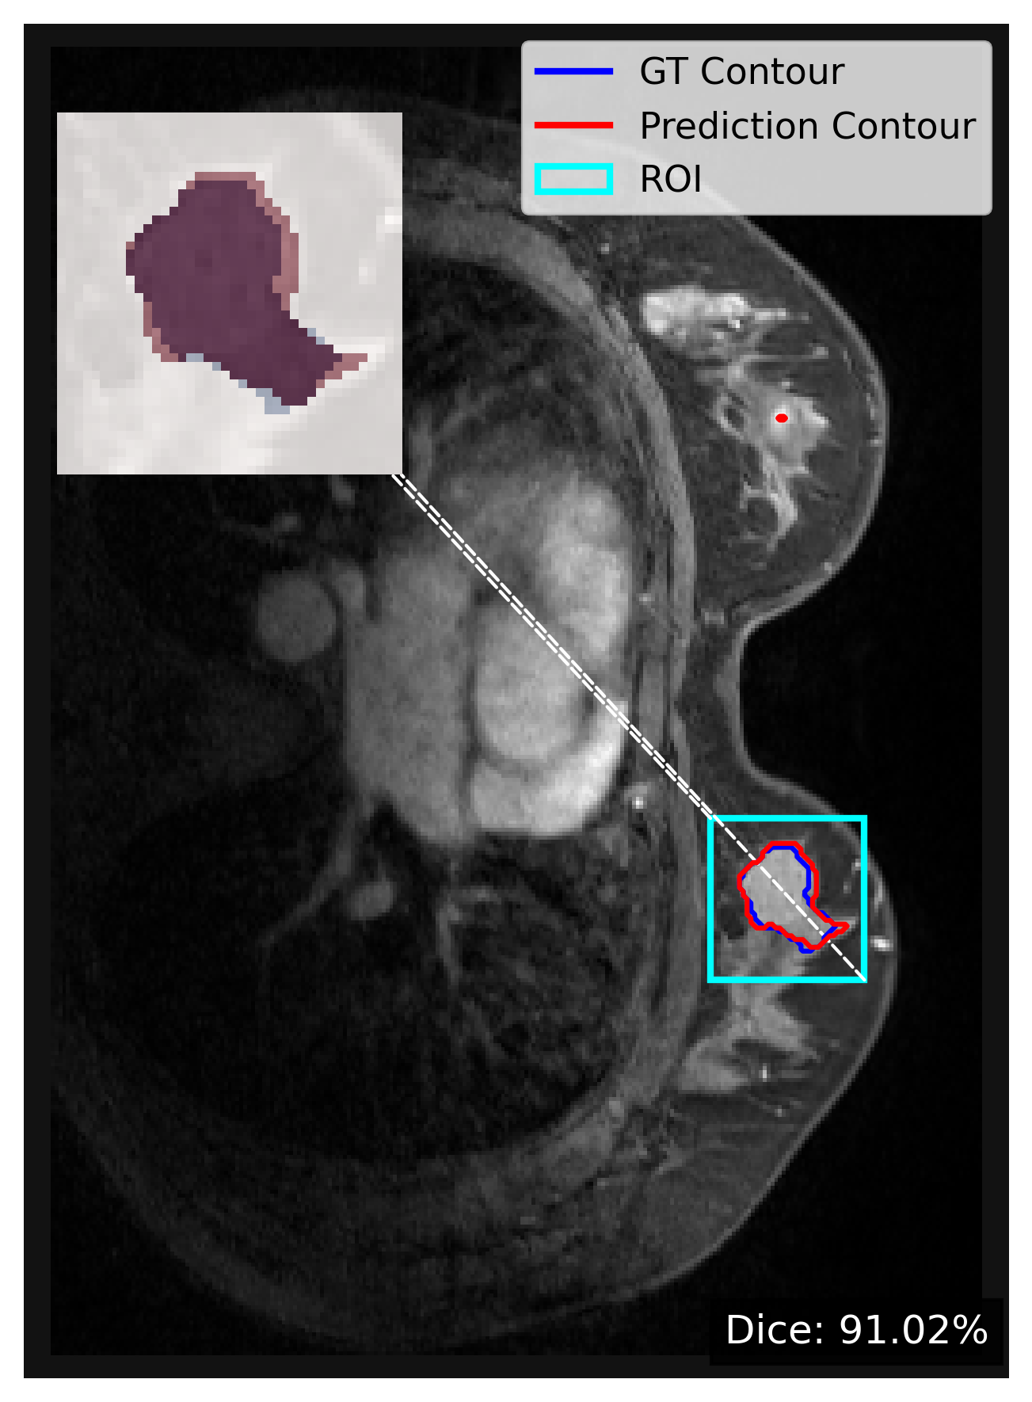
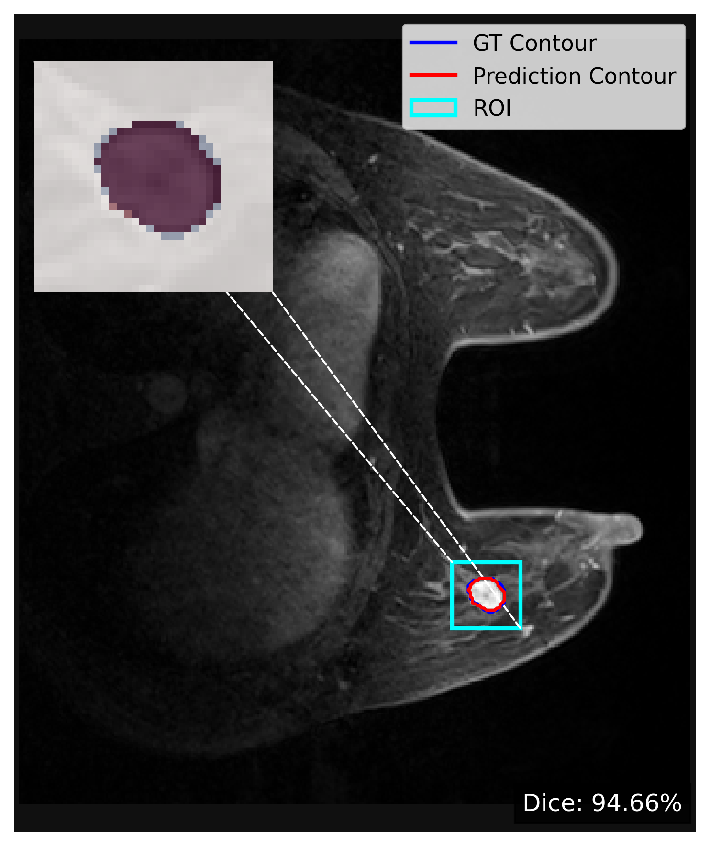
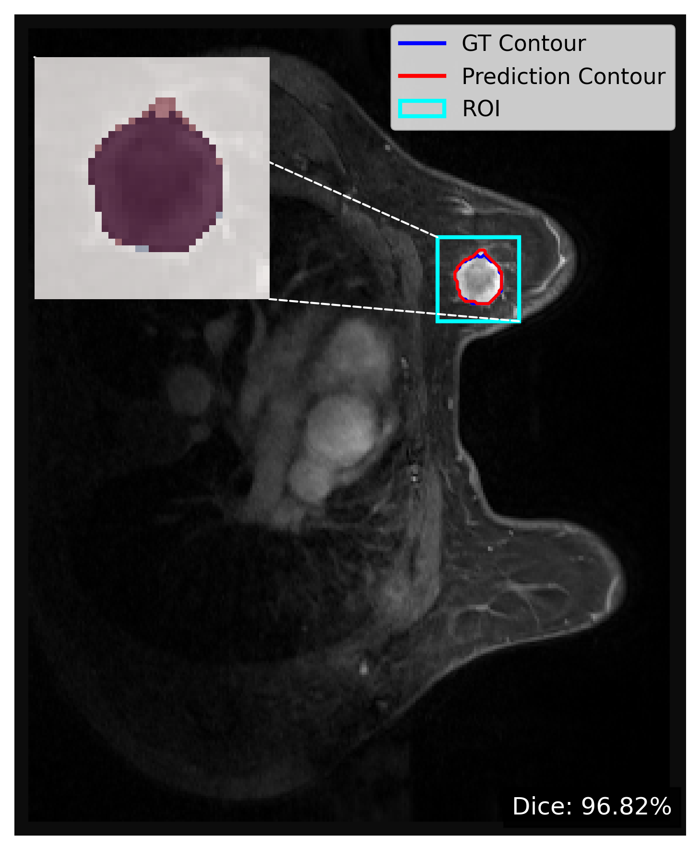
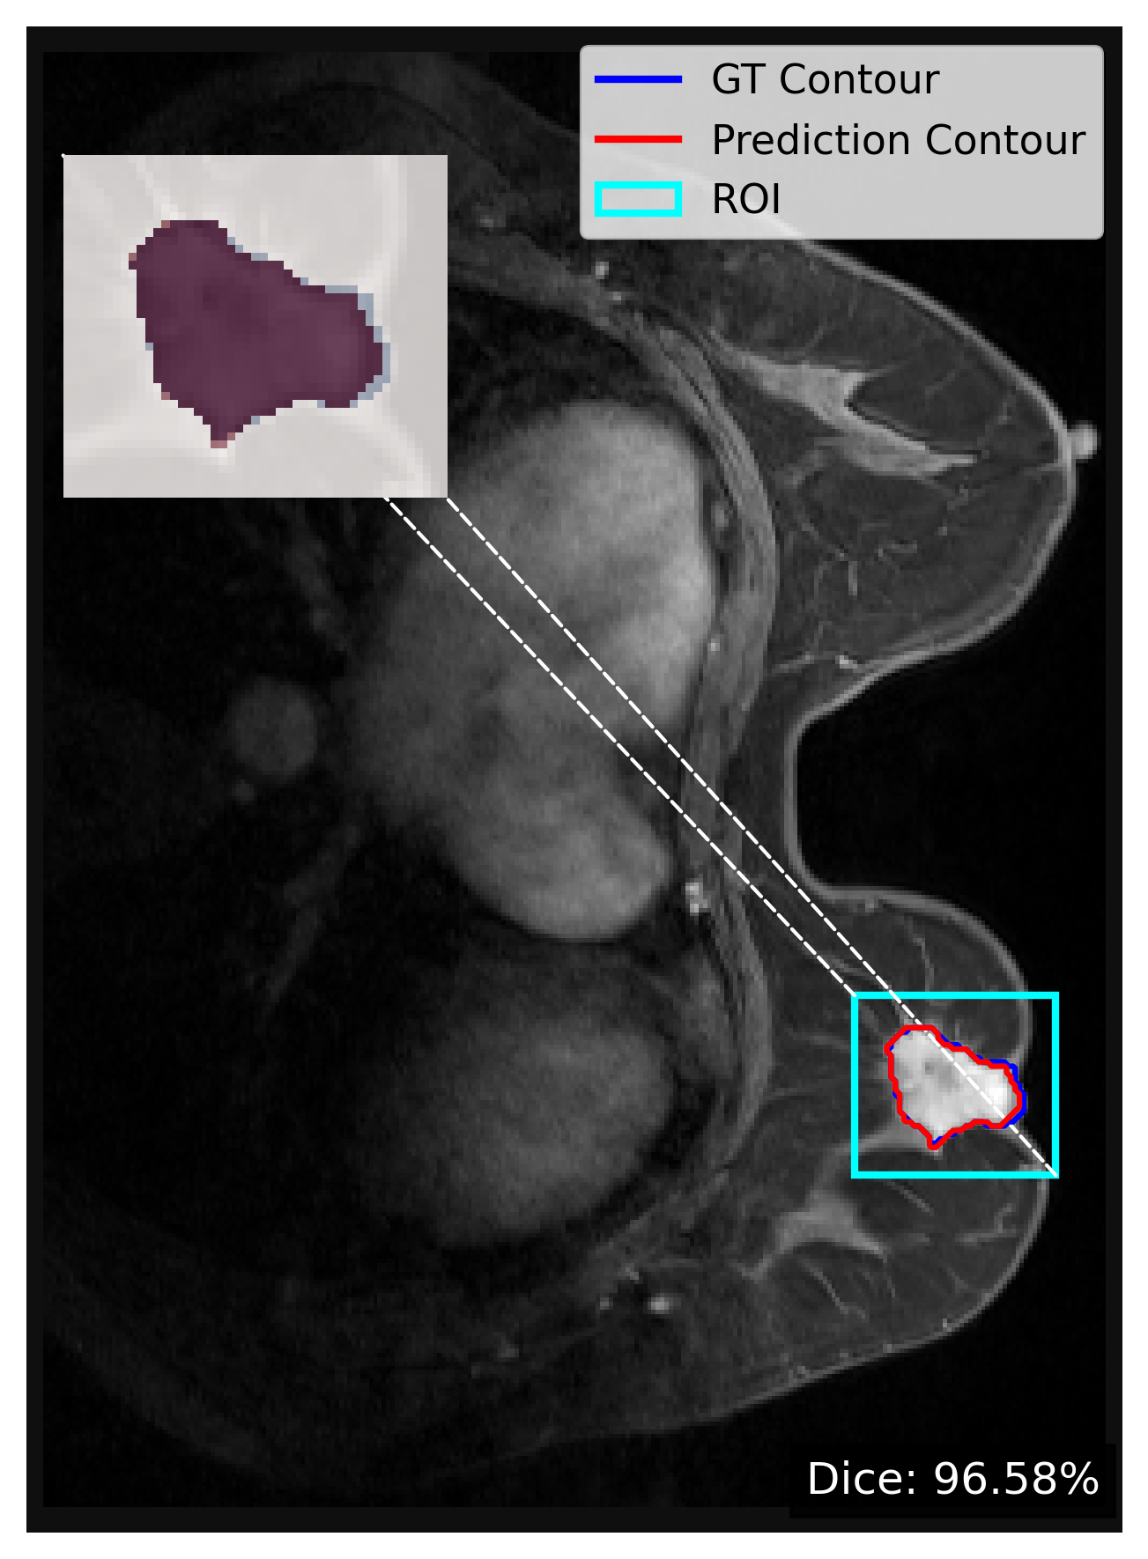
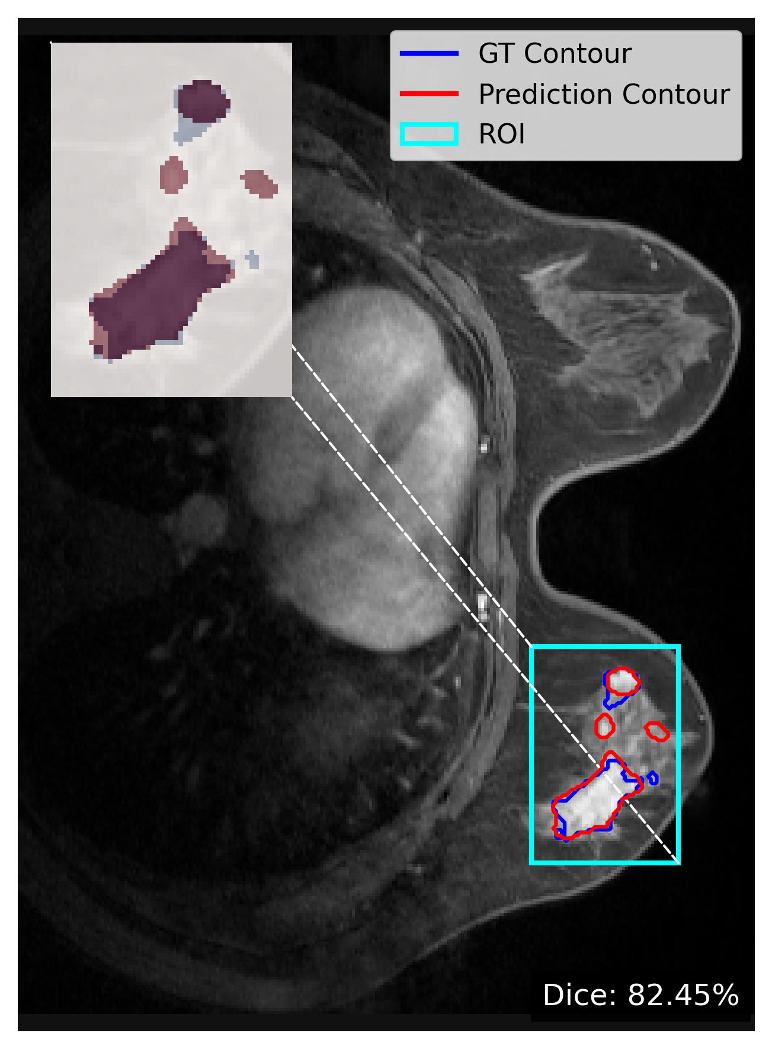
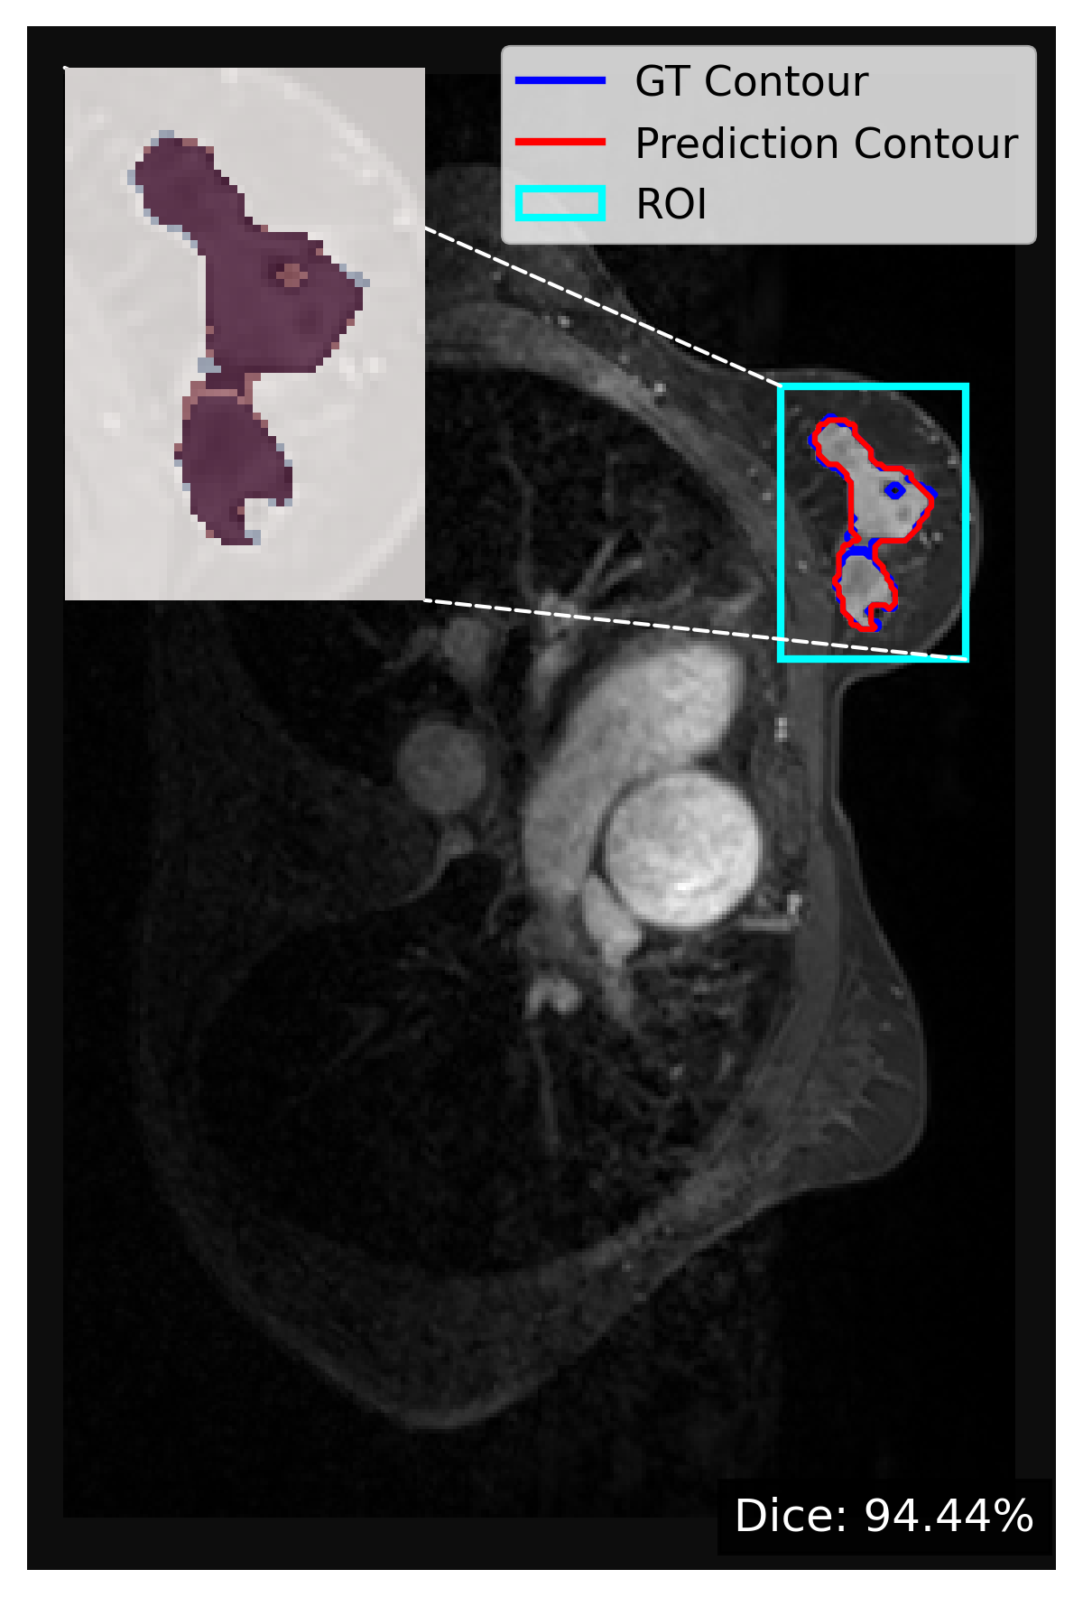
Sectional view of segmentation

Slide 11
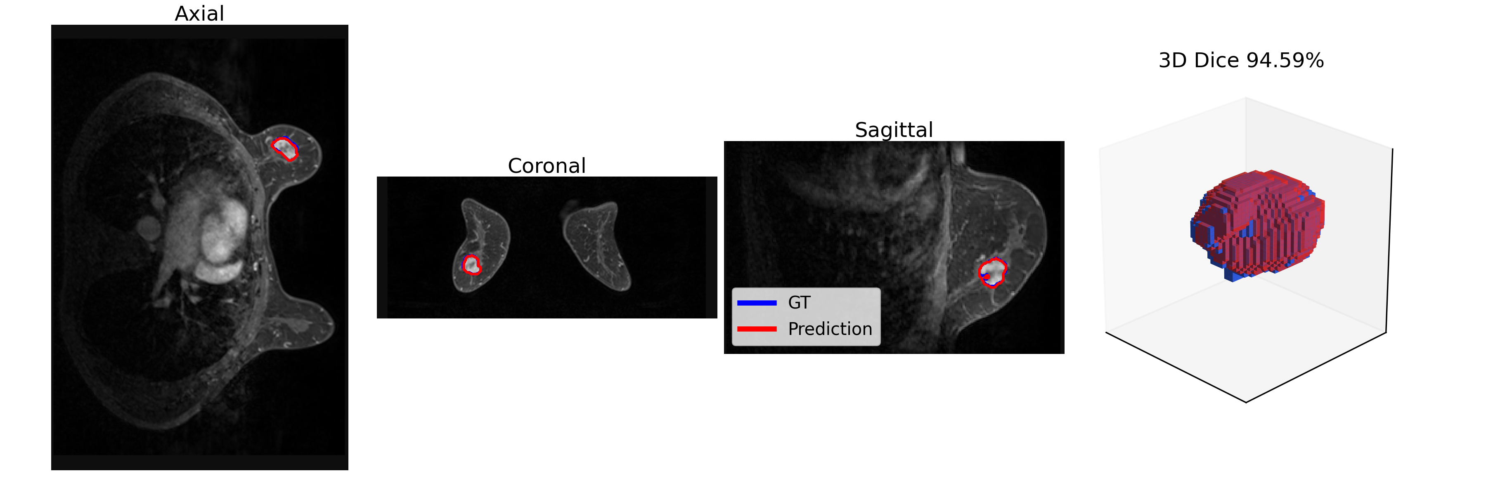
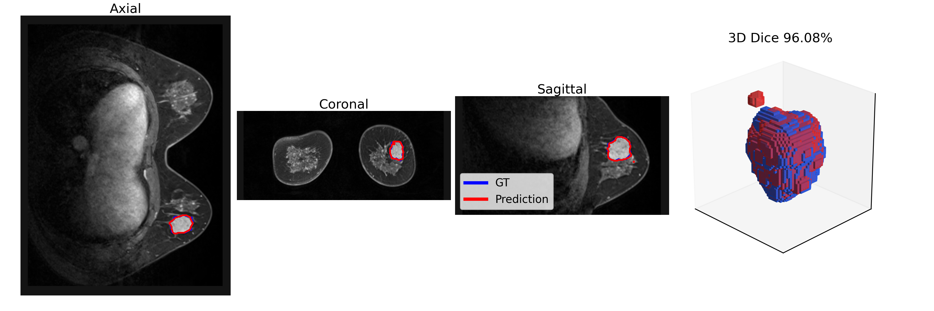
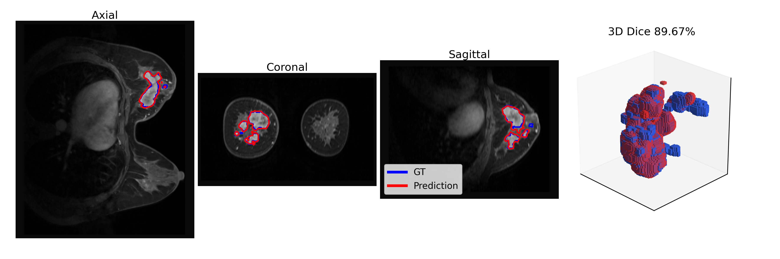
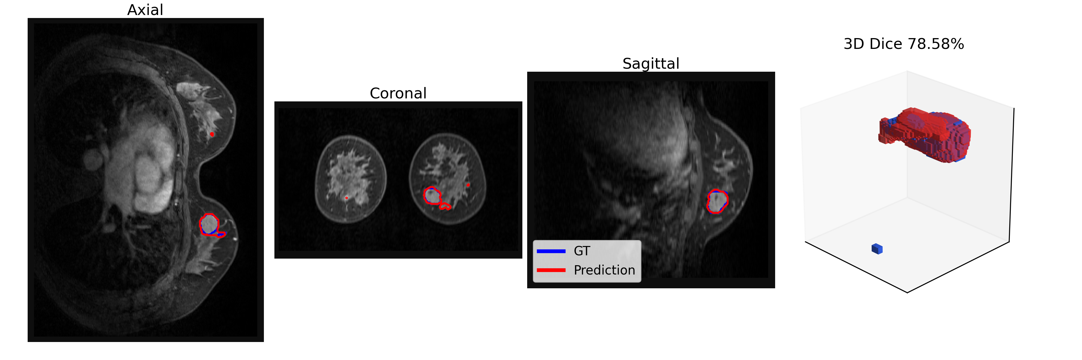
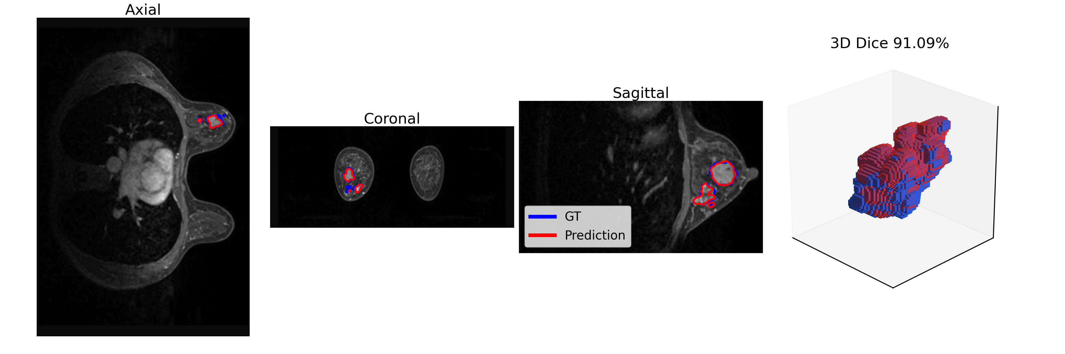
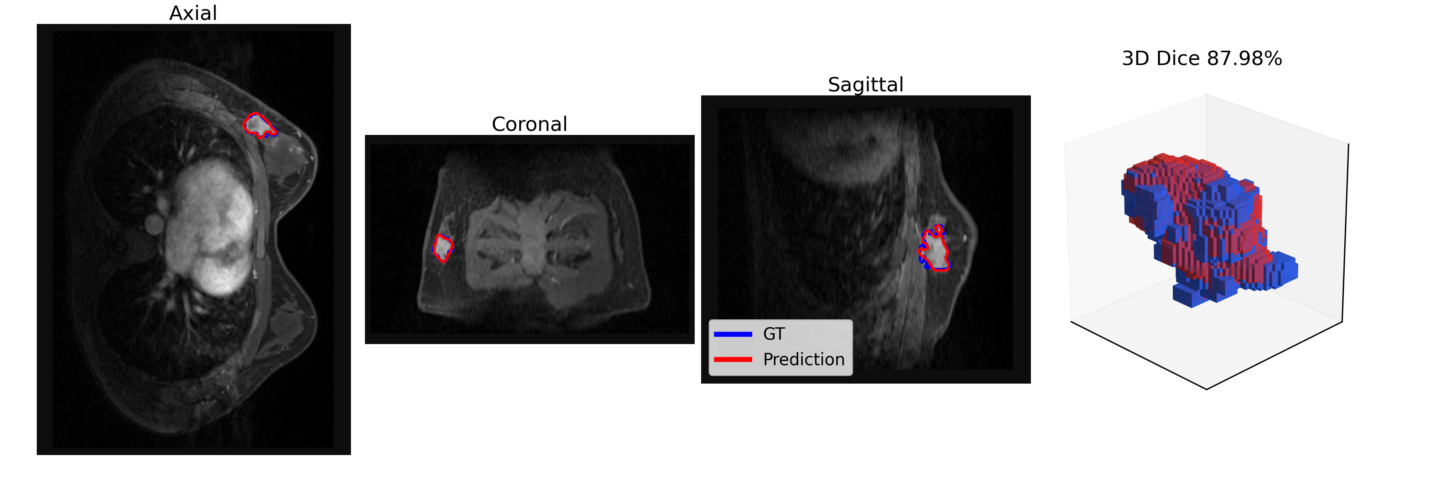
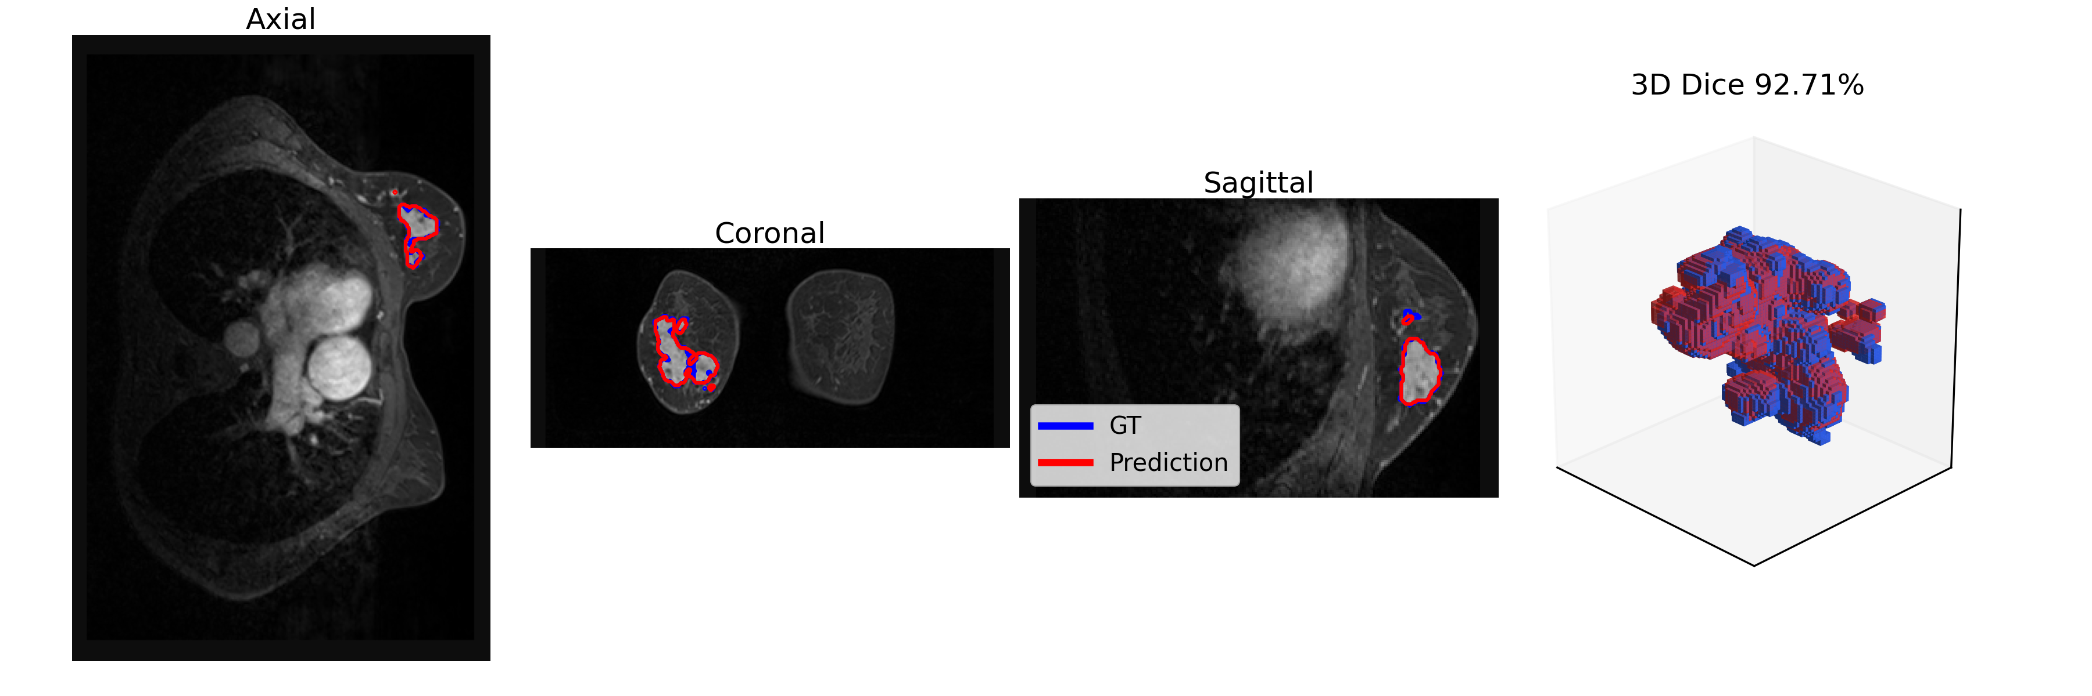
3D voxel-wise segmentation

Slide 12
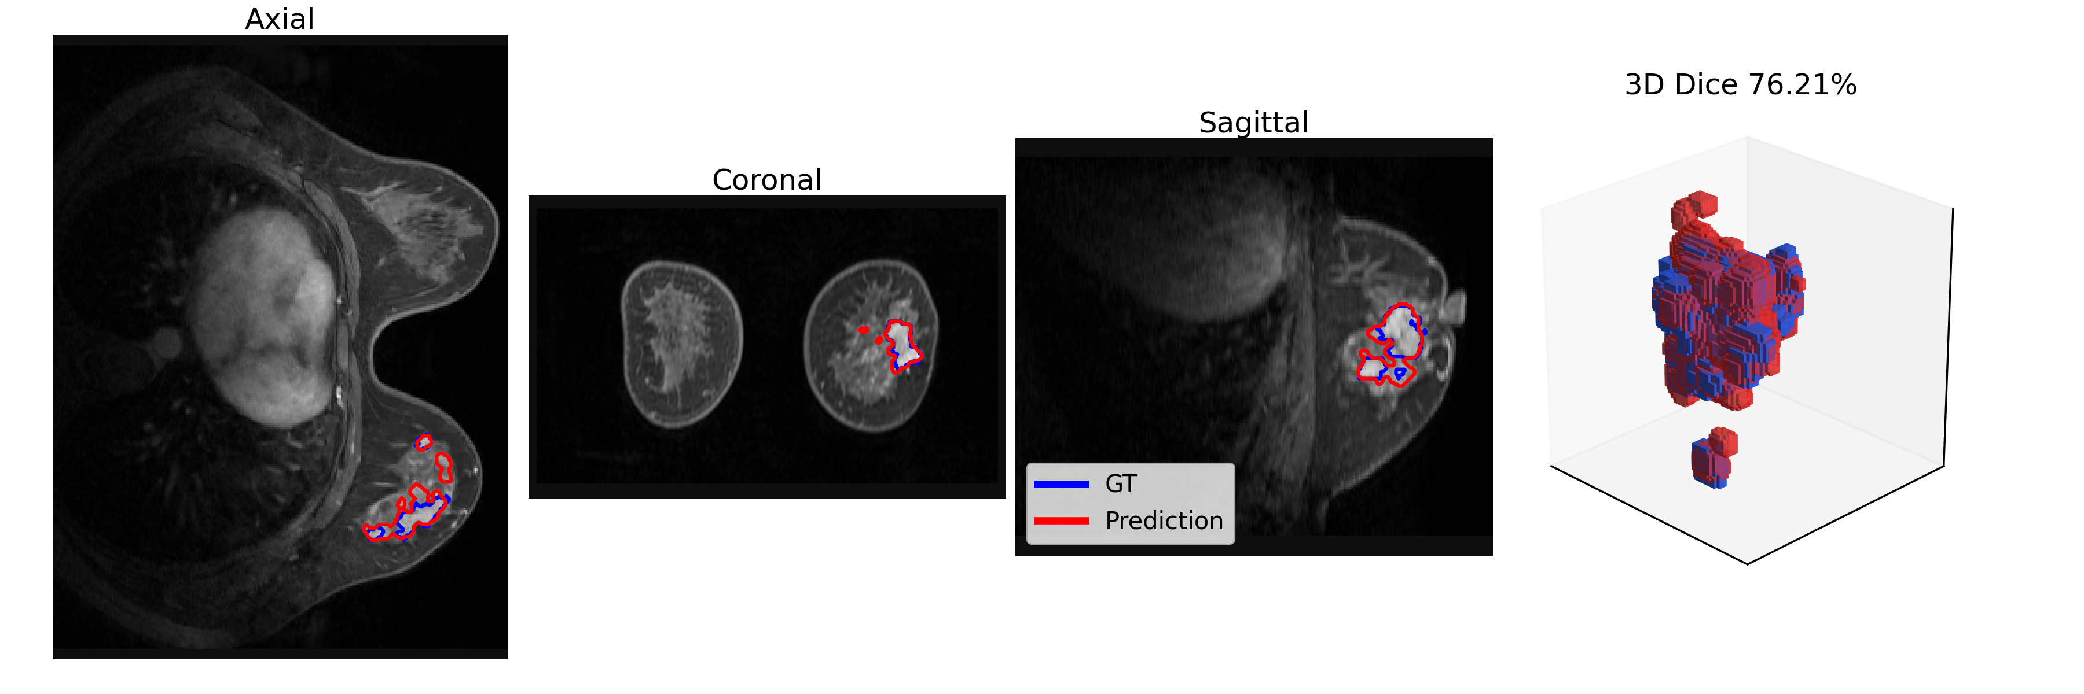
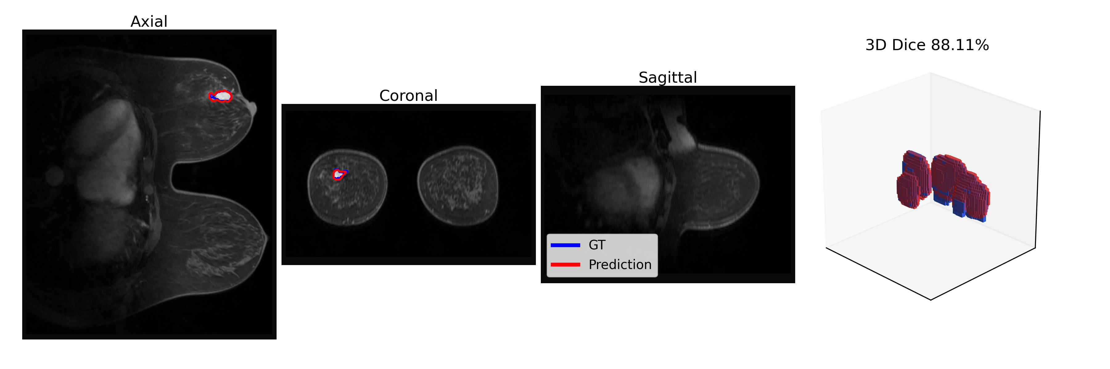
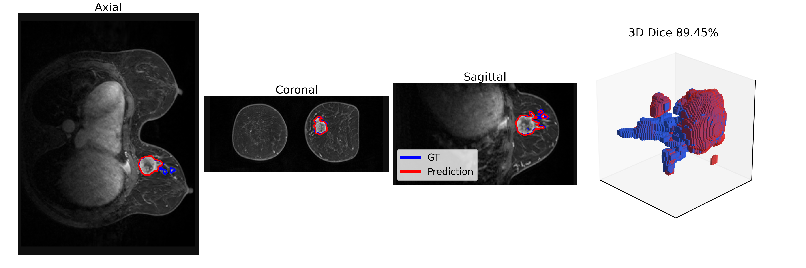
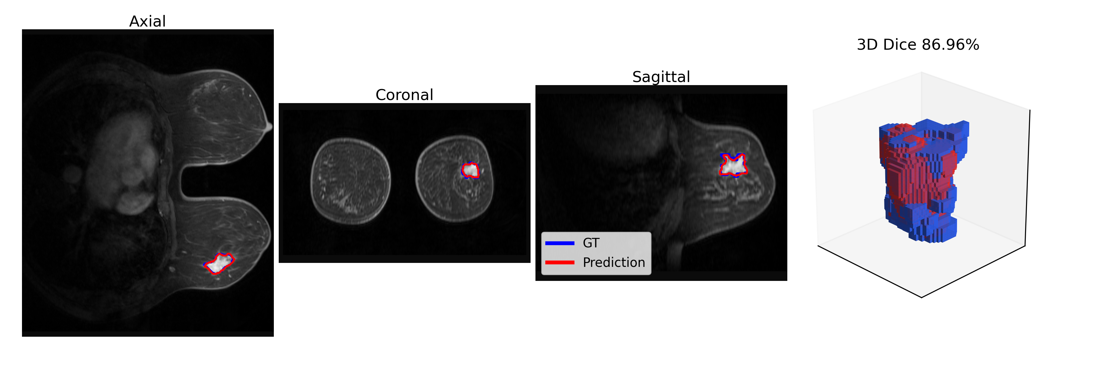
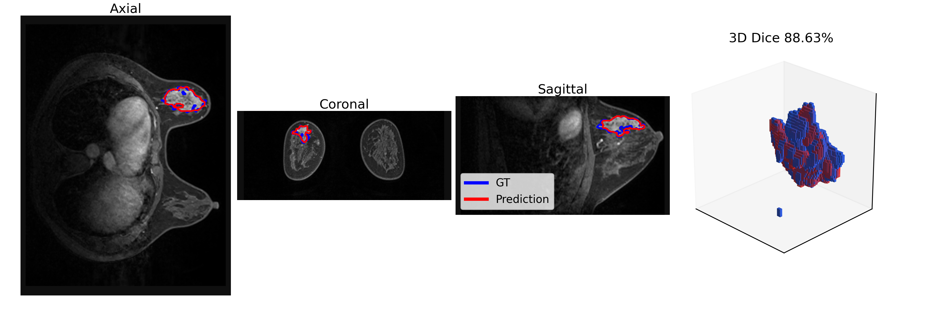
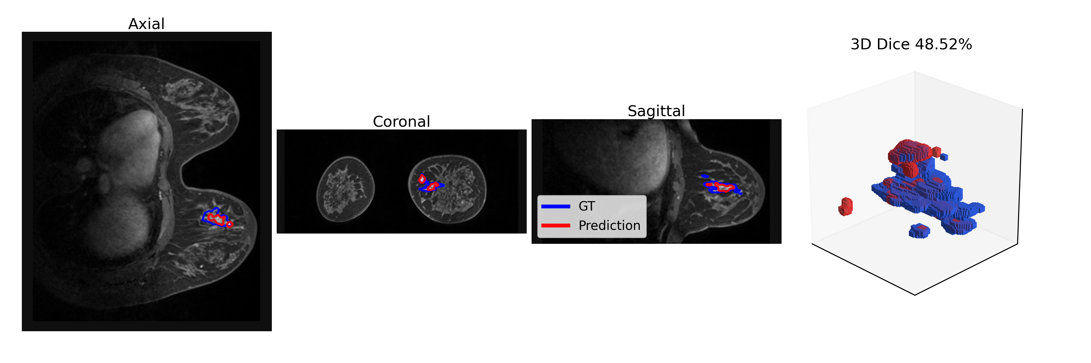
3D voxel-wise segmentation

Slide 13
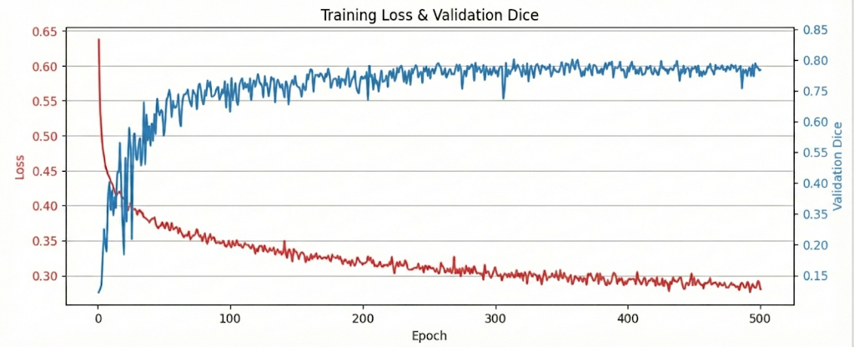
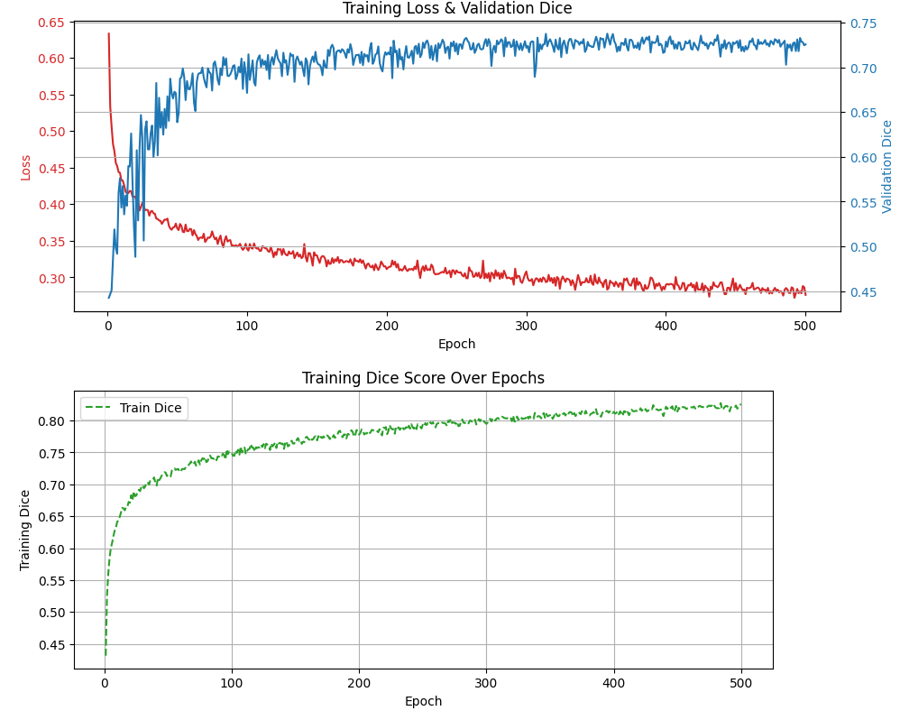
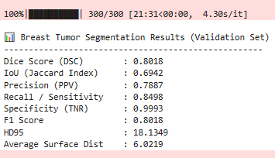
MAMA MIA data set (Public)
DCE-MRIs of 1506 patients With expert annotations.

Slide 14
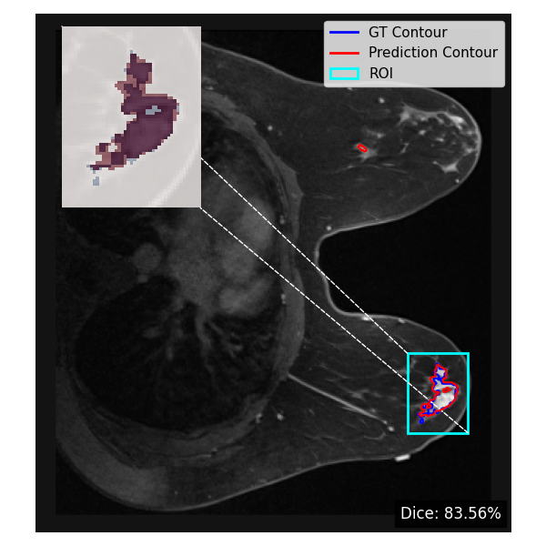
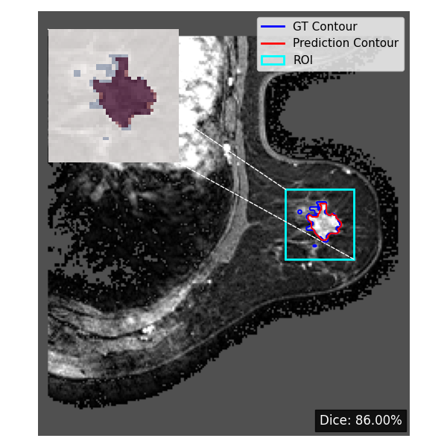
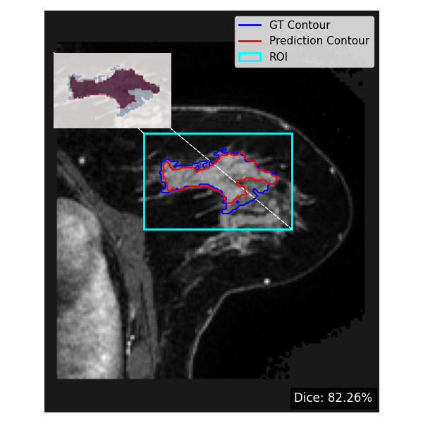
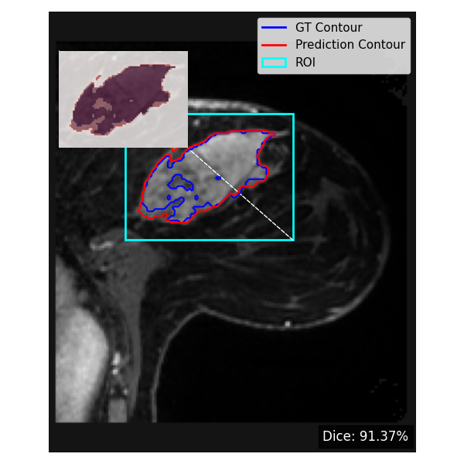
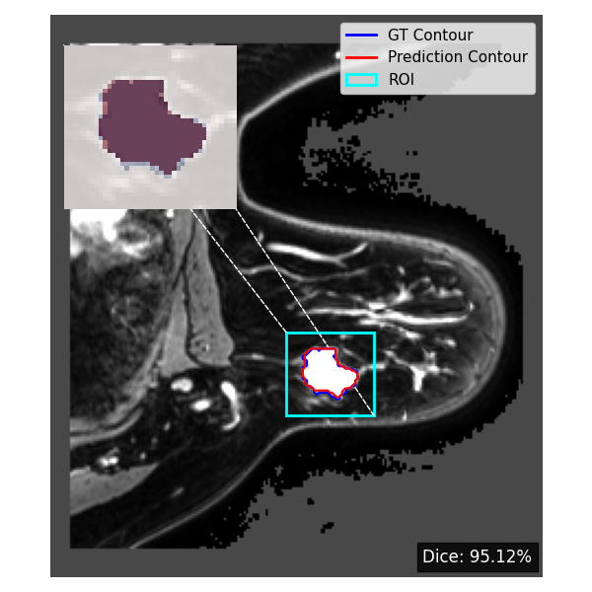
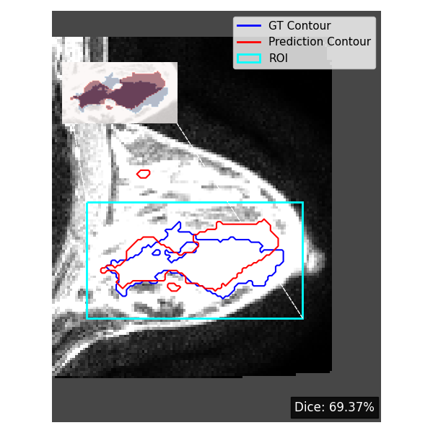
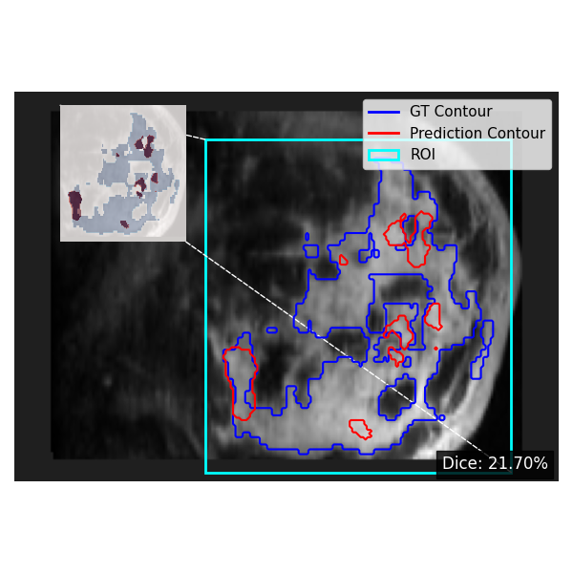
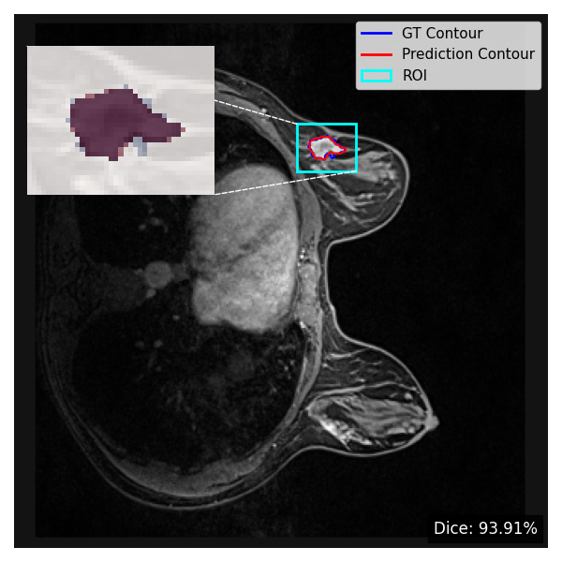
Sectional view of overlay of GT & segments

Slide 15
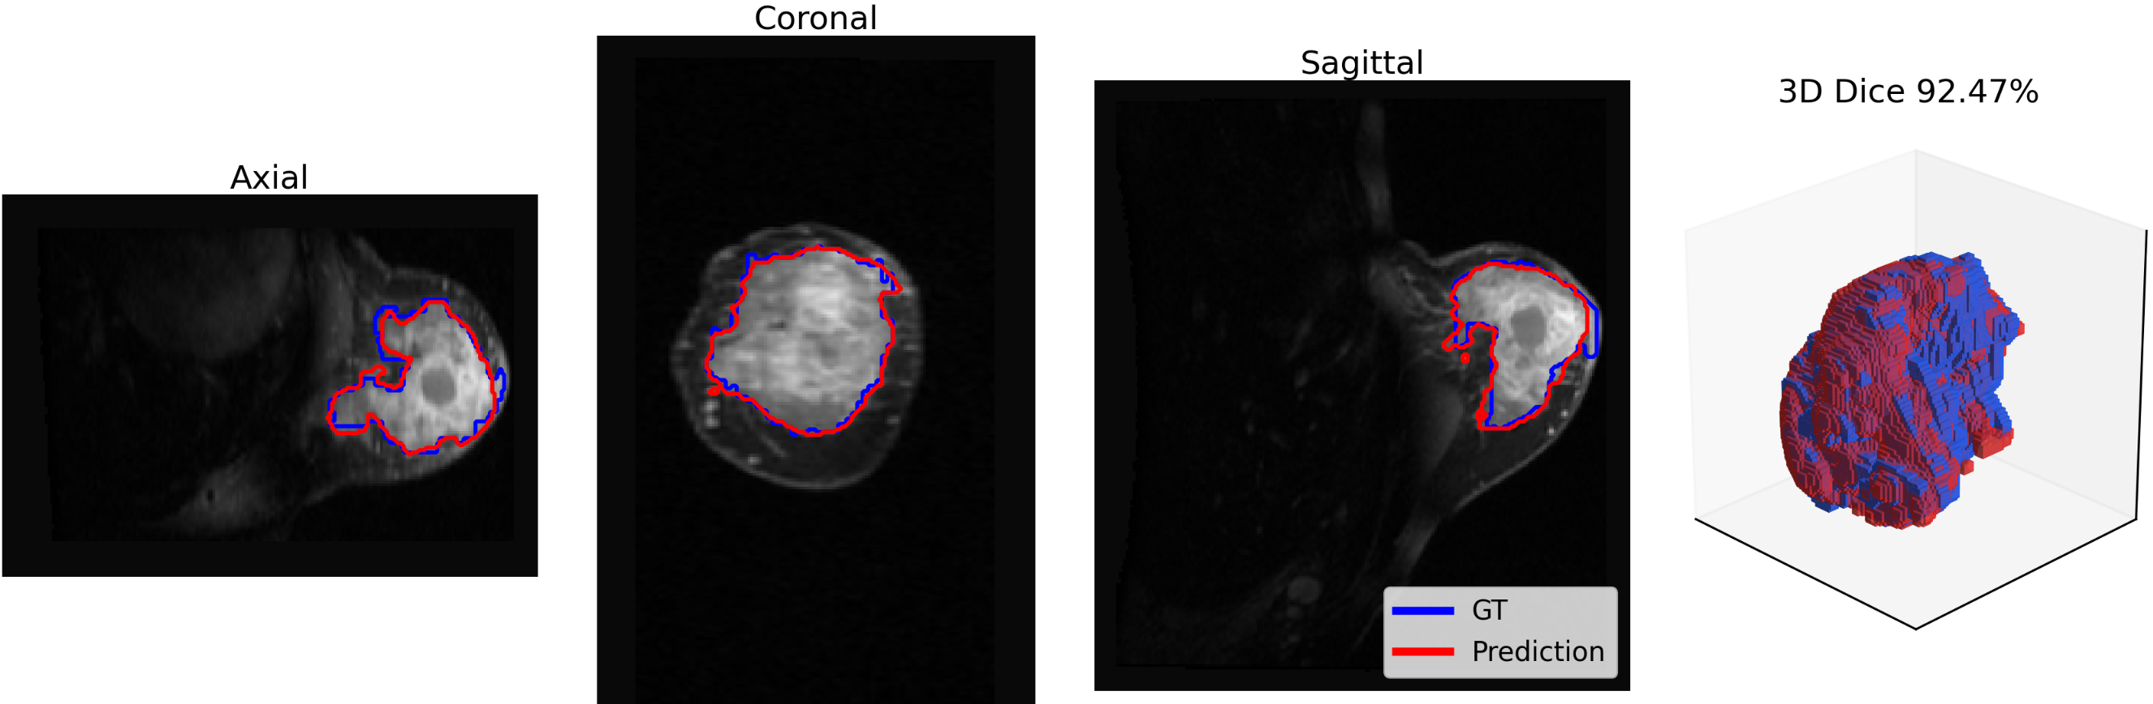
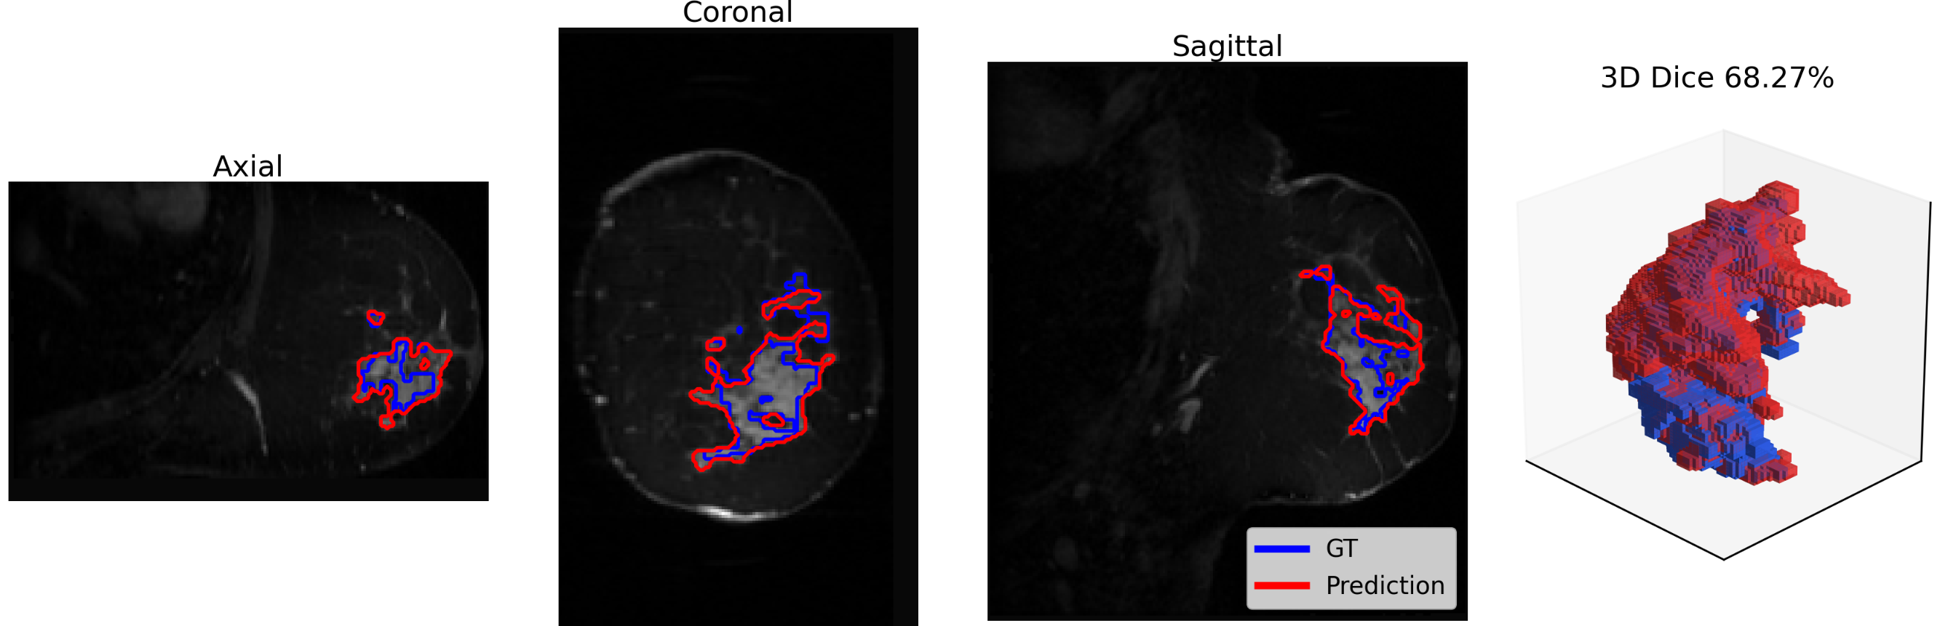
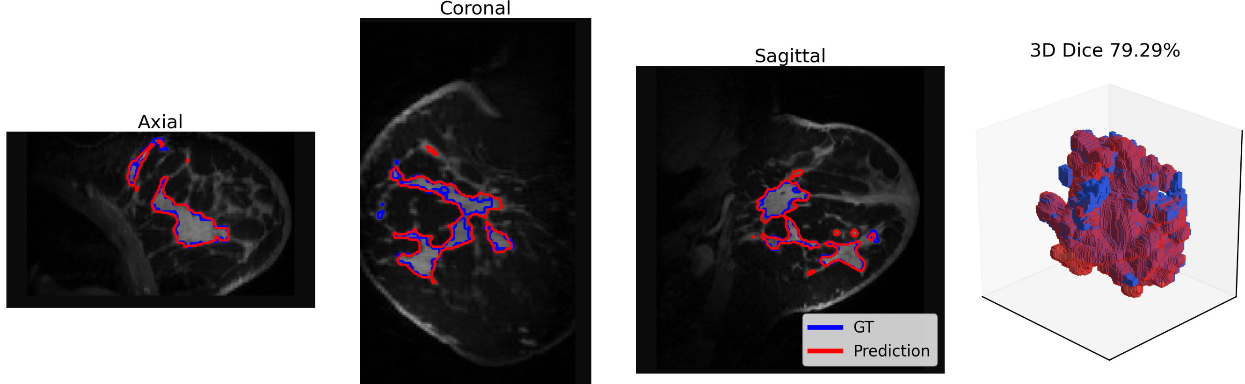
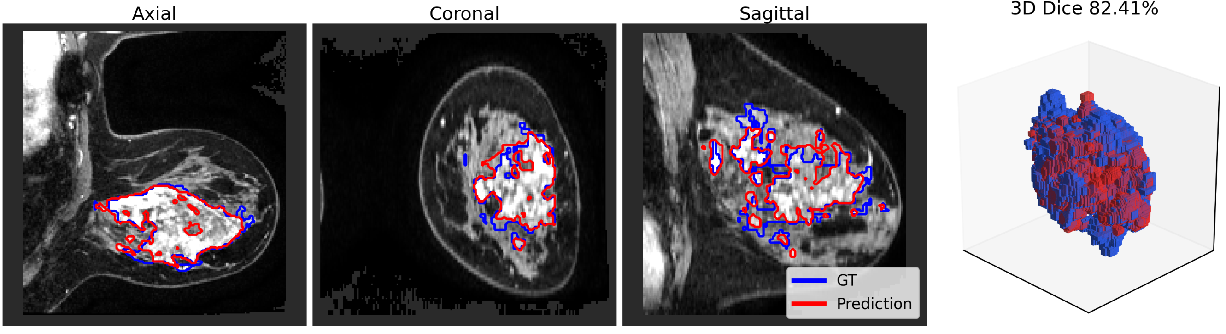
3D voxel-wise segmentation

Slide 16
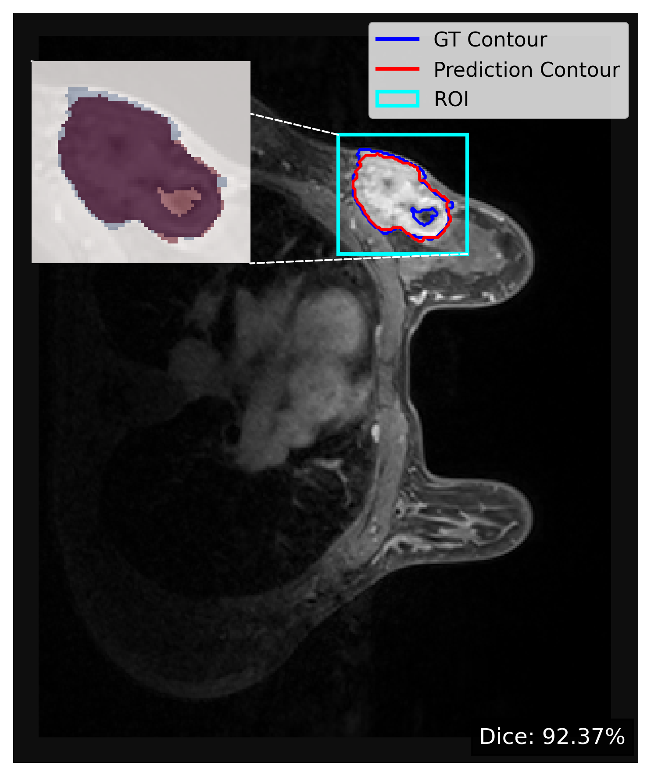
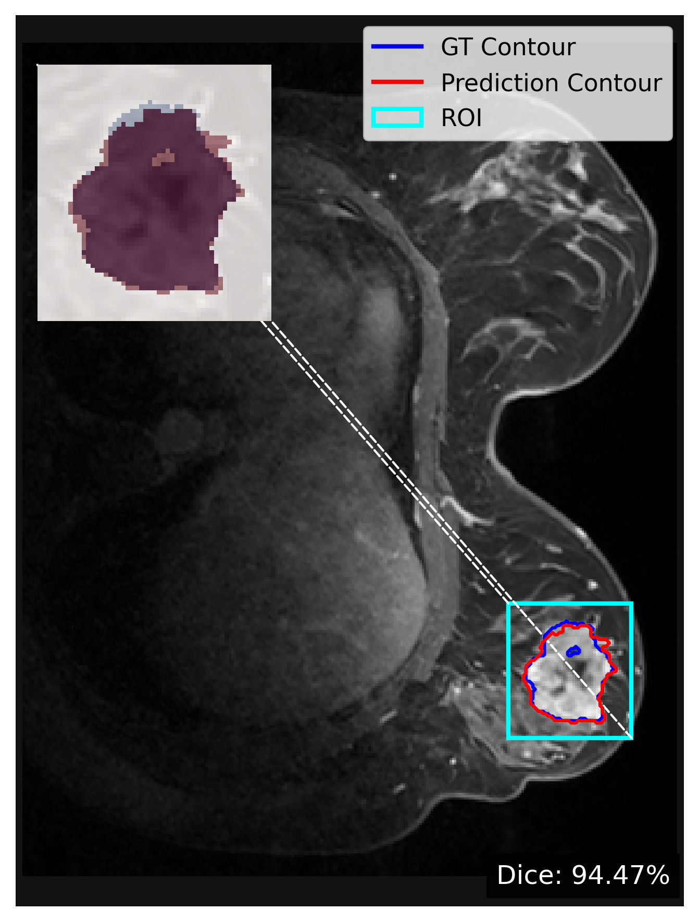
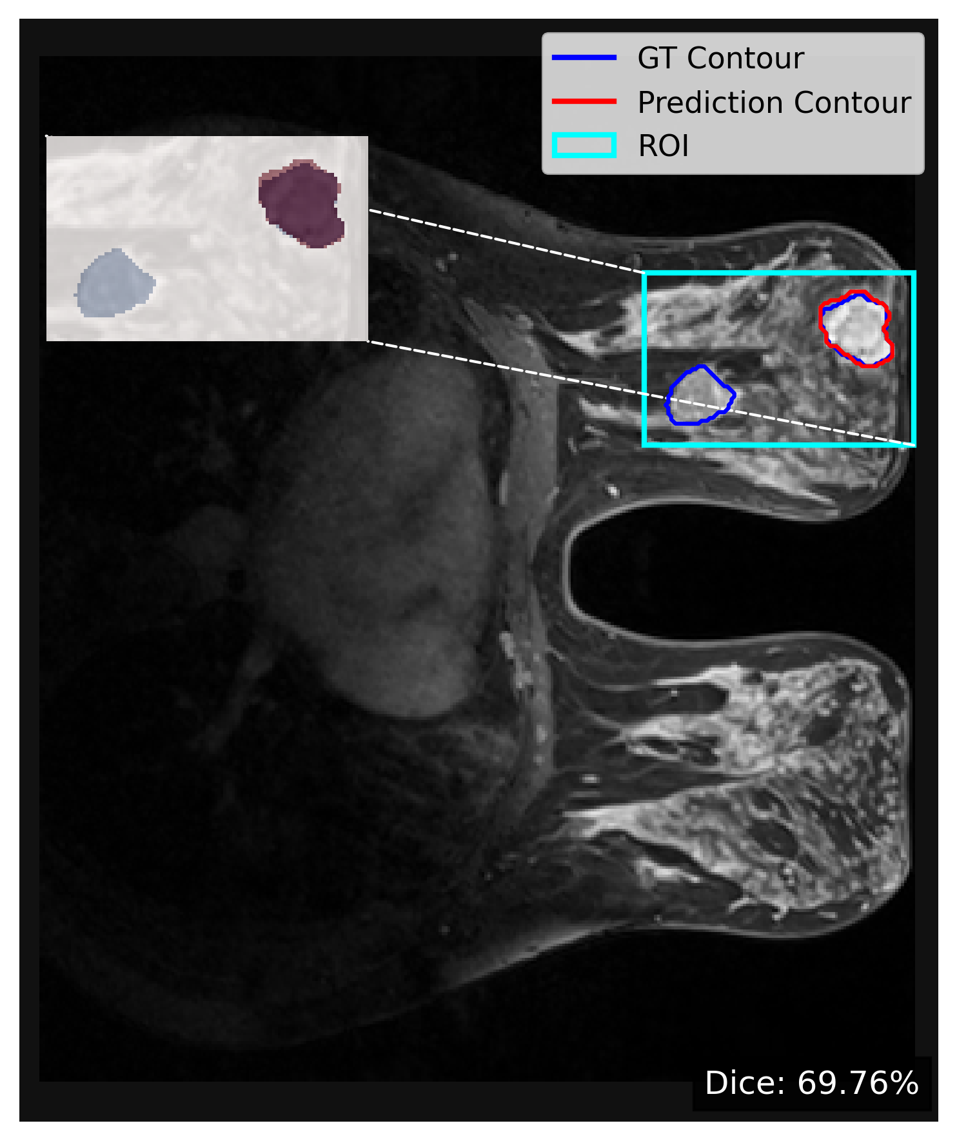
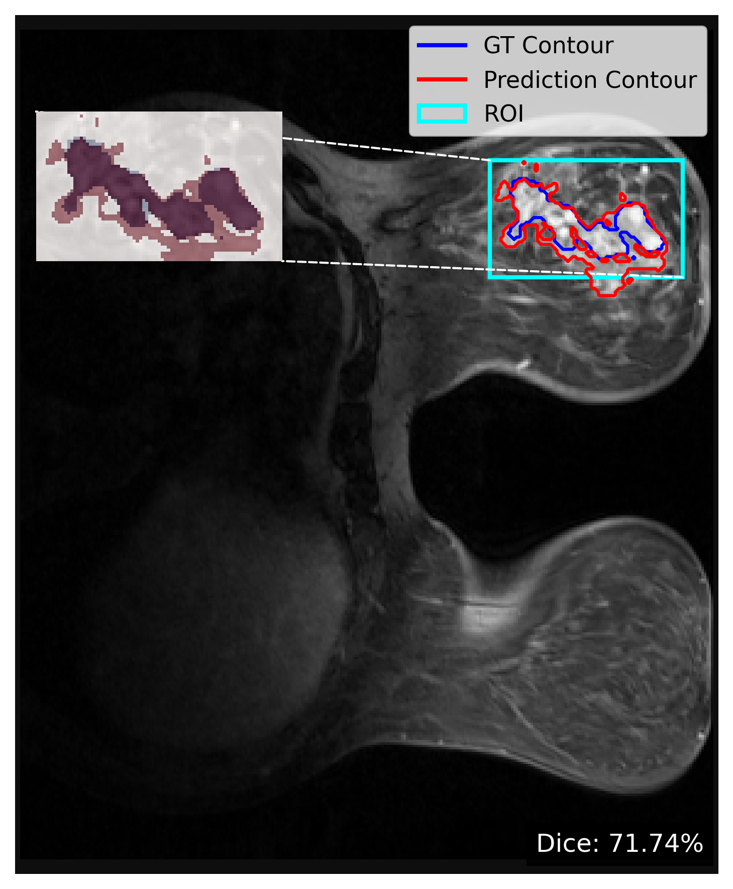
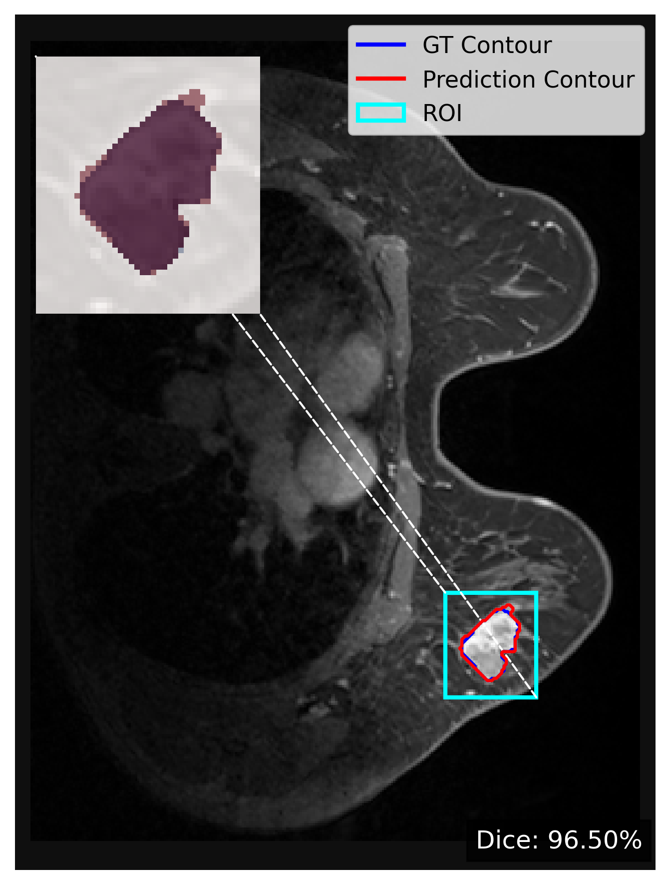
Patient test cases for generalisation of model

Slide 17




3D voxel-wise segmentation

Slide 18
Ablation study
 |  | Dice Score (DSC)% | IoU (Jaccard Index) | Precision (PPV) | Recall / Sensitivity | Specificity (TNR) | F1 Score | HD95 | Average Surface Dist
Yunnan dataset | Base line 1 | 80.53 | 69.82 | 80.71 | 83.85 | 99.99 | 80.53 | 36.95 | 9.378
 | Base line 2 | 82.80 | 72.86 | 79.71 | 89.86 | 99.99 | 82.80 | 31.69 | 6.714
 | Base line 3 | 86.44 | 77.49 | 87.44 | 87.09 | 99.99 | 86.44 | 18.20 | 2.533
Mama mia dataset |  | 80.18 | 69.42 | 78.87 | 84.98 | 99.93 | 80.18 | 18.13 | 6.02
Random Patient data |  | 74.4 | 62.55 | 66.95 | 90.63 | 99.96 | 74.44 | 41.5 | 8.6

Slide 19
Progress so far
S.No. | Approved Budget | Consumed till Date
Manpower | Rs 15,12,000 | Rs 4,50,000 (Approx.)
Consumables | Rs 20,000 | Zero
Equipment | Zero | Zero
Travel | Zero | Zero
Contingency | Rs 20,000 | Zero
Total | Rs 15,52,000 | ~ Rs 4,50,000
Staff hired: 1 (sandeep) Students hired: 2 (Ganeev and Armaan)
Workflow
 | Years
 | 1st |  |  |  | 2nd
Segments/Quarters | Q1 | Q2 | Q3 | Q4 | Q1 | Q2 | Q3 | Q4
Project Planning and Data Collection | ✔ | ✔
AI Model Development and Training | ✔ | ✔ | ✔
Model Validation, Testing, and Tumor Model Generation | ✔ | ✔ | ✔
Hyperthermia Treatment Simulation and Optimization
Experimental testing and Validation
Documentation and publications
Research article status:
Peer-Reviewed Journal Articles (Under review) 1. Nain, Sandeep, Neeraj Kumar, and Pramod Kumar Avti “Magnetic hyperthermia and its dependency on nanoparticles, tissues, and other critical parameters: a comparative study” in Biomedical Physics & Engineering Express.
Ready for Communication Articles 1. S. Nain, N. Kumar, and P. K. Avti, “CFD-based Design and Performance analysis of digital twin for cancer prediction and treatment using magnetic fluid hyperthermia.
2. S. Nain, N. Kumar, J. Sachdeva, Ganeev T, Keshav J, Custom HFSSCE Attention model for 3D breast cancer segmentation and prediction.

Slide 20



Future directions and collaborations
Mass breast screening
AI model for tumor detection and verification along with radiologist/pathologist review
External Partners: Rajindra Hospital, Patiala and PGI Chandigarh
In touch with Incubation and Commercialisation with Thapar Venture Labs and Punjab Govt
Fig. Breast Screening Program for data collections with Govt. support.
Important Remarks:
To assist doctors for early diagnosis of any abnormalities from large patient screening data.
Cancer classification and segmentation estimation for treatment planning for critical patients.
Potential for any radiogenomics studies or histopathology studies with integration of AI models on real-time data.
To build a base for data repository compliance for breast cancer patient.

Slide 21
References
Hirsch, L., Huang, Y., Luo, S., Rossi Saccarelli, C., Lo Gullo, R., Daimiel Naranjo, I., ... & Sutton, E. J. (2021). Radiologist-level performance by using deep learning for segmentation of breast cancers on MRI scans. Radiology: Artificial Intelligence, 4(1), e200231.
Li, H., Qin, P., Yuan, X., & Chen, Z. (2025). HCMA-UNet: A Hybrid CNN-Mamba UNet with Axial Self-Attention for Efficient Breast Cancer Segmentation. arXiv preprint arXiv:2501.00751.
Garrucho, L., Kushibar, K., Reidel, C. A., Joshi, S., Osuala, R., Tsirikoglou, A., ... & Lekadir, K. (2025). A large-scale multicenter breast cancer DCE-MRI benchmark dataset with expert segmentations. Scientific data, 12(1), 453.
Star, C. S. P. S., Inbamalar, T. M., & Milton, A. (2025). Automatic semantic segmentation of breast cancer in DCE-MRI using DeepLabV3+ with modified ResNet50. Biomedical Signal Processing and Control, 99, 106691.

Slide 22

Thanks

